Slide 1
RCTL research
PhD projects

Slide 2
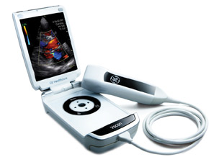
2nd PhD: Sten Roar Snare
Graduated from NTNU in 2011.
Contributions:
Added 2D segm. support
Added spline contour support.
Applications:
2D multi-chamber segm.
2D septum thickness segm.
US view detection & scoring

Slide 3
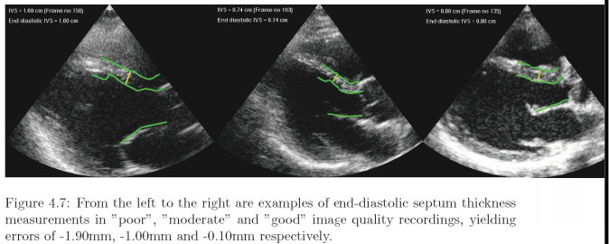
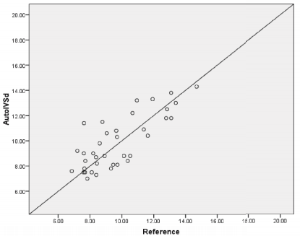
Snare & al.: Automated Septum Thickness Measurement - A Kalman Filter Approach, Comp. Met. & Prog. in Biomedicine 2011.
Setup:
2D ultrasound data.
Three connected spline curves that track both sides of the septum wall and the mitral valve.
Application:
Automatic measurement of the septum wall thickness (indicator of too high blood pressure).
Automatic algorithm vs. reference.

Slide 4
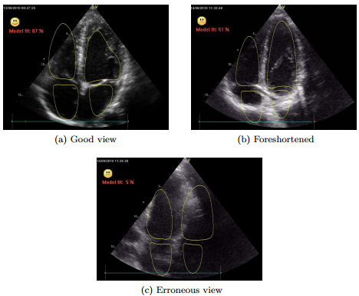
Snare & al.: Real-time Scan Assistant for Echocardiography, IEEE UFFC, 2012
Setup:
Automatic fitting of 4 connected models, corresponding to the 4 cardiac chambers.
Scoring of the segmentation “fitness” to asses model vs. data agreement.
Application:
Make ultrasound easier to use.
Proved real-time feedback on the extent of which the desired anatomy (4 cardiac chambers) is really imaged.

Slide 5
3rd PhD: Engin Dikici
Graduated from NTNU in 2013.
Contributions:
Improved edge-detection (graph-cut etc.)
Added FEM-based regularization of multi-scale segm.
Added bidirectional segm.
Applications:
3D US LV segm.

Slide 6
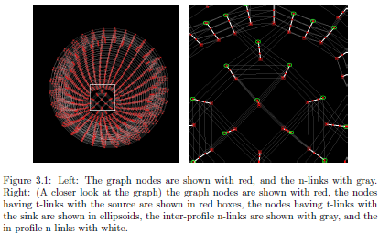
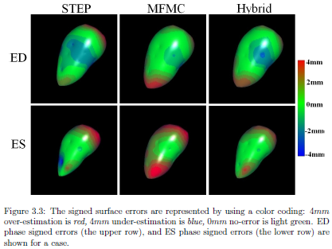
Dikici & al.: Graph-Cut Based Edge Detection for Kalman Filter Based Left Ventricle Tracking in 3D+T, Echo, IEEE Computing in Cardiology 2010
Setup:
Create a graph by connecting the edge-detection profiles.
Use min flow/max cut algorithm to simultaneously detect the «optimal» edge in all edge profiles.
Application:
Improved edge detection in 3D US LV segmentation.

Slide 7
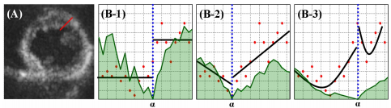
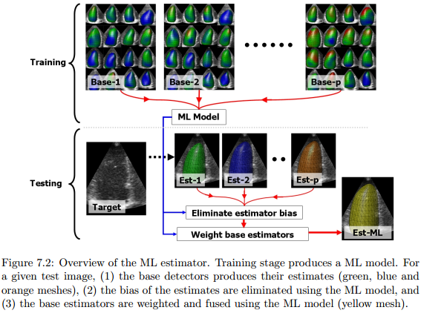
Dikici & al: Generalized Step Criterion Edge Detectors for Kalman Filter Based Left Ventricle Tracking in 3D+T Echoc, Stat. Atlases and Comp. Models of the Heart 2012
Setup:
Piecewise constant, linear and quadratic regression of surface-normal intensity profiles.
Weighted sum of detected edges with const/linear/quadratic regression,based on trained weighting parameters.
Application:
Improved edge-detection in 3D ultrasound segmentation.
Intensity profile (red), regression-lines (black), cost function (green), detected edge (blue)

Slide 8
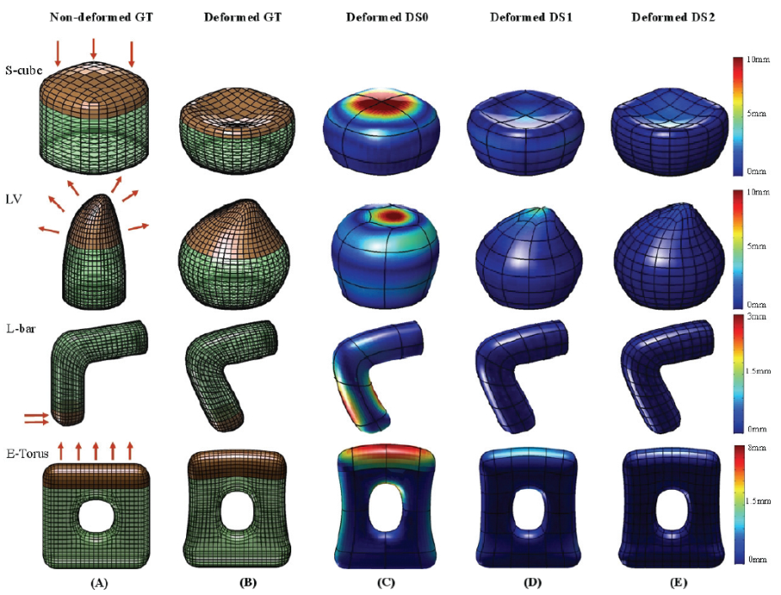
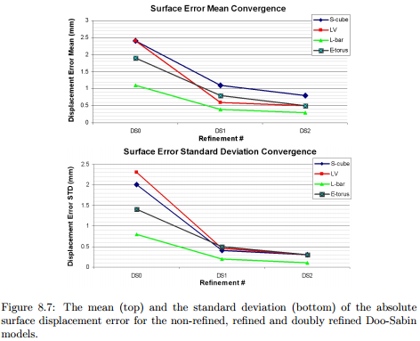
Dikici & al.: Doo-Sabin Surface Models with Biomechanical Constraints for Kalman Filter Based Endocardial Wall Tracking in 3D+T Echocardiography, British Machine Vision Conference 2012
Setup:
Finite element method-based regularization of meshes (stiffness matrix).
Application:
Improved and consistent regularization model behavior across scales.
FEM simulations of biomechanical regularization, independent of scale/resolution.

Slide 9
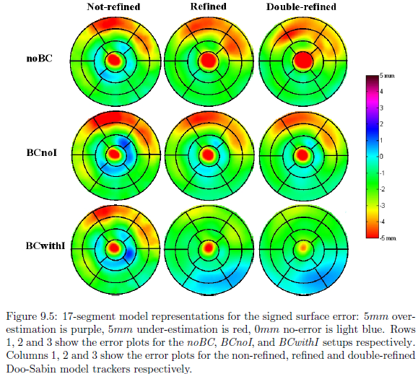
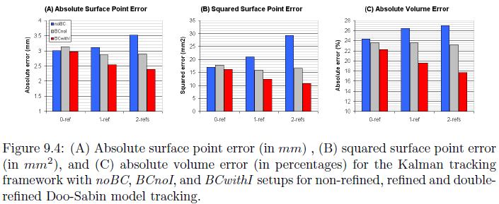
Dikici & al.: Doo-Sabin Surface Models with Biomechanical Constraints for Kalman Filter Based Endocardial Wall Tracking in 3D+T Echocardiography, British Machine Vision Conference (BMVC), 2012
Setup:
Use stiffness matrices from FEM modeling to regularize model during segmentation.
Application:
Improved and consistent regularization model behavior across scales.

Slide 10

PhD projects in-progress
4th PhD: Sigurd Storve (NTNU)
Combine image with tissue-velocity data to update model.
Application: Improved 2D US LV segmentation.
5th PhD: Jørn Bersvendsen (GEVU/CCI)
3D US aortic outlet segmentation.
Application: Aortic diameter for surgery planning.
6th PhD: Pavan Annangi (GE Global research, Bangalore)
Multi-slice (2.5D) US bladder segmentation.
Several others are also using the software as part of their research.

